Slide 1


Predicting the Price of used cars
Abner Nole

Slide 2
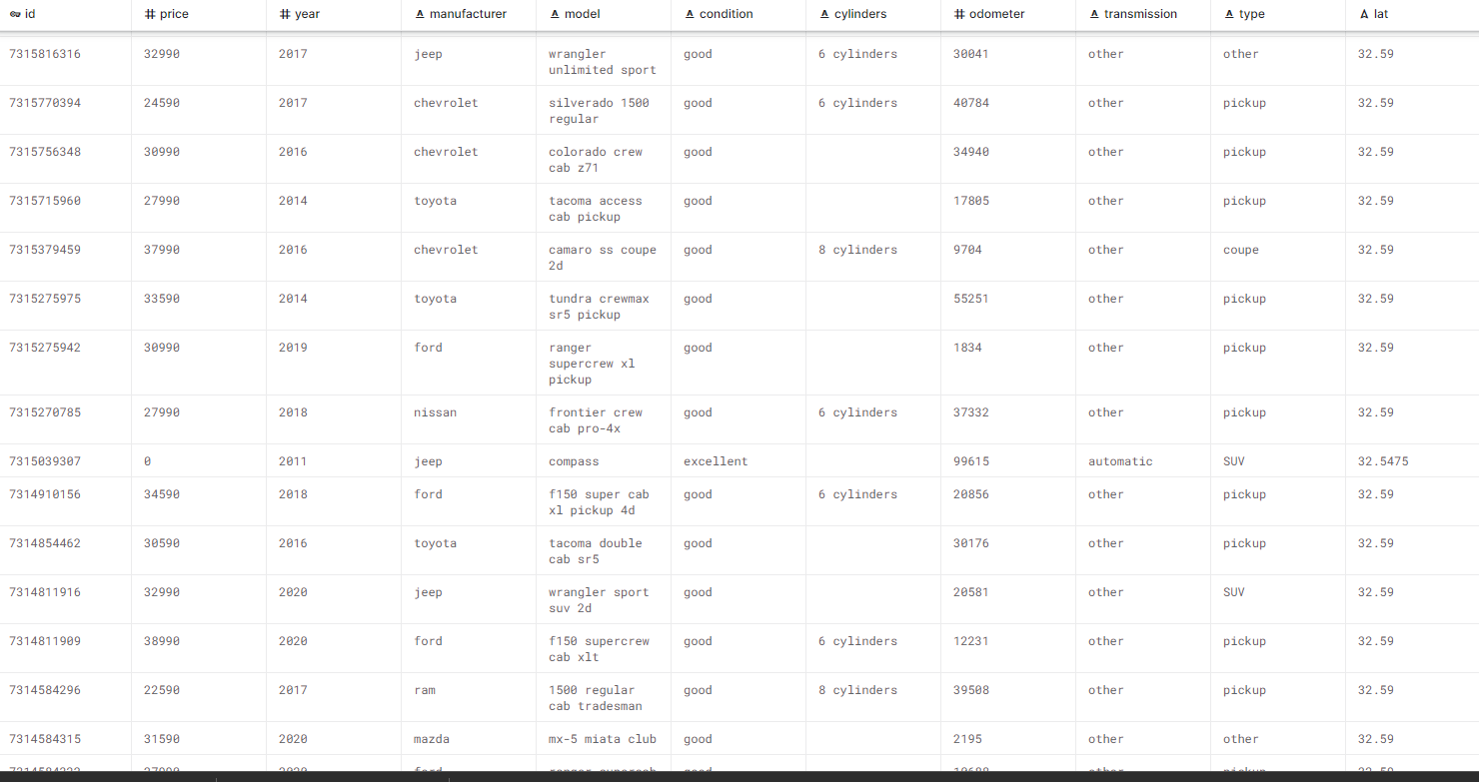
Dataset Used Cars
SOURCE:KAGGLE

Slide 3
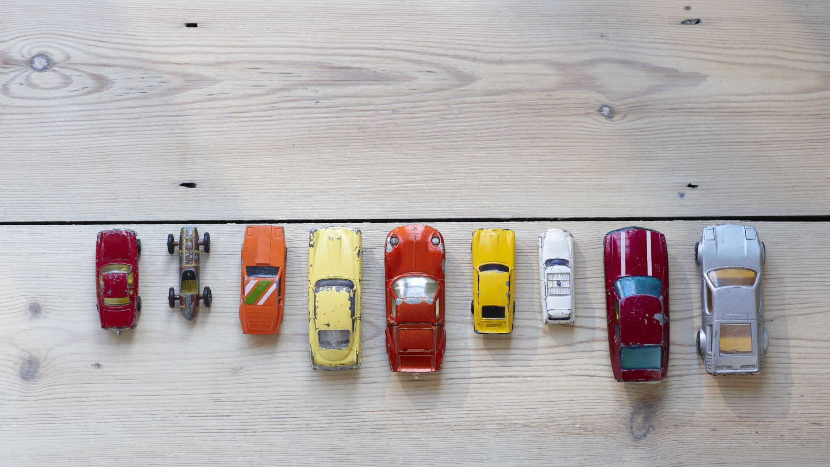
Exploratory Data Analysis EDA Model Development Linear Regression Model Random Forest Regressor Model GBT Regressor Model
How much can your used car be worth?

